Slide 1


Polycystic Ovarian Syndrome Diagnostic Tool
R Shiny Web Application
Sept 2022 Cohort | Sarah Beth Powell

Slide 2

What you should know about
PCOS
(Polycystic ovary syndrome)
What is PCOS?
Affecting an estimated 5 to 6 million women in the United States, PCOS is the most common cause for infertility. The exact cause of PCOS is unknown, but research suggests that elevated levels of androgens and insulin maybe related to the condition. PCOS impacts women of all ages, even post-child bearing age.
Common Symptoms & Impacts
An estimated
$8 Billion
was spent to diagnose & treat PCOS just in the year 2020.
Excess hair growth on face & body
Irregular cycles & Infertility
Weight gain
Acne
Diabetes
Heart Disease
Reference to Endocrine Society

Slide 3
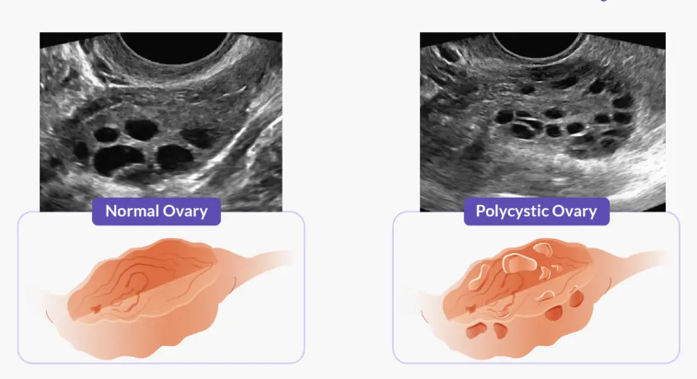
About the data
Kaggle PCOS Data was collected from 10 different hospitals across Kerala, India.
Two different files containing infertility & fertility patient data in a Comma Separated Value (CSV) file and an Excel file.
45 features included in the fertility dataset which includes various hormone levels from blood tests and symptoms of the patients.

Slide 4
Objectives
1
Create a logistic regression model which predicts the probability of PCOS diagnosis
2
Create a tool to assist providers in diagnosing PCOS

Slide 5
Objective 1
Create a logistic regression model.

Slide 6
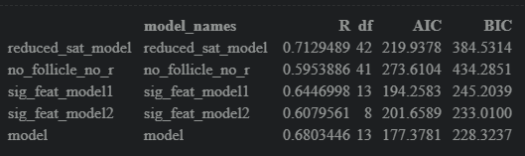
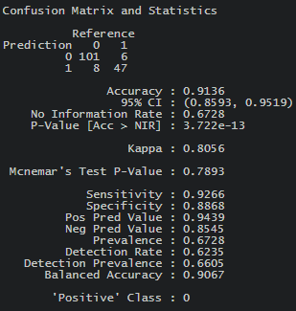
Model Creation & Evaluation
1
Create a saturated model.
2
Create a ‘reduced saturated model’ with features with VIF < 5.
3
Remove most significant feature with the lowest p-value to create another model.
4
Create a model with only significant features.
5
Using stepwise selection, create a model with minimal AIC.
6
Evaluate with AIC, BIC, McFadden’s Pseudo R Squared.

Slide 7
Objective 2
Create a diagnostic tool for providers.

Slide 8
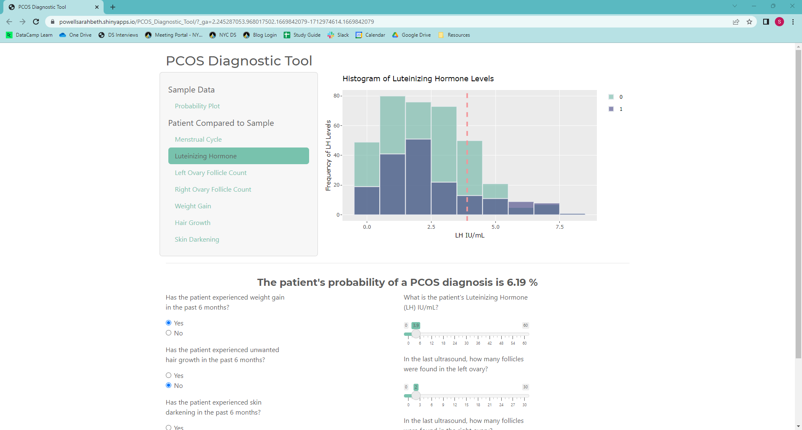
Objectives

